Slide 1

Project for Wireless Mesh network channel assignment
CSE 812
Xiaoyan Li, Zhongzheng Chen, Chang Liu

Slide 2

Wireless Mesh network-multi-channel-unicast

Slide 3

Mesh network problems
Network performance metric
Link optimization
Interference problem
Mesh network optimization
Load topology
Routing approaches
Static or dynamic

Slide 4

Mesh Network optimization
Internet

Slide 5
Is minimizing inference the same as maximizing traffic?
Internet
Channel B
Channel A
Channel C
Channel A
Channel C
Link removal also results in graph partition, channel assignment and routing approach problems
Hassen A, Mohamed O, Shamala S, Nor A, 2016

Slide 6
Link optimization methods
Spanning tree link optimization
Raniwala and Chiueh, 2005; Kim and Suh, 2010
Traffic profile link optimization
Skalli et al., 2007; Subramanian et al., 2008
Flow-based link optimization
Chiu et al., 2009; Mogaibel et al., 2012
Power control link optimization
Chaudhry et al., 2012
High quality metric link optimization
Draves et al. 2004

Slide 7
Interference
Channel 1
Channel 1
Node A
Node B
Node C
Channel 1
Intra-flow interference
Node A
Node B
Channel 1
Node C
Channel 1
Channel 1
Node C
Node D
Hidden node inference
Inter-flow inference
Node A
Node B
Node D
External source
External source inference
Rate inference
High rate Channel 1
Channel 1
Channel 1
Node A
Node B
Low rate Channel 1
Node C
Node D
Node C
Node D

Slide 8
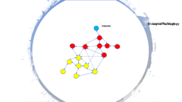
Load topology
Logic topology
Interference
Traffic topology
Routing strategy

Slide 9

Known traffic Topology
Logical Topology
Internet
Internet

Slide 10
Static or Dynamic
Load
Dynamic or static
Dynamic load
Static load
Logic graph
Static solution
Logic graph dynamic
Logic graph static
routing
routing
Routing dynamic
Routing static
Routing dynamic
Routing static

Slide 11
Static or Dynamic
Static
Dynamic
Flow response
Easy to implement
Flexible
No response time
Response time
Stable
Optimize capacity

Slide 12
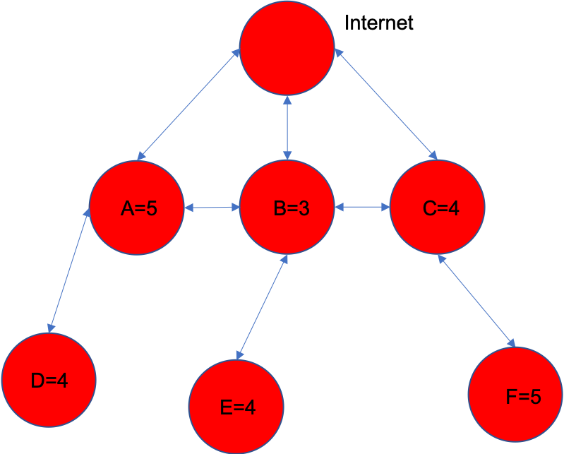
What is the good measure?
Channel 1
Node A
Node B
Min interference
High flow median
High network capacity
High total flow
Channel 1
Node C
Node D
Internet
A
B
C
Internet
A
B
C
F = 5
F = 4
F = 3
T = 5
T = 4
T = 3
D
E
F

Slide 13

Disagreement
Disconnect network
Connectivity
Broken nodes
Determined by logic and load topology
Fault tolerance
Routing
Client
Stability
Join and switch nodes
Load topology change

Slide 14
Comparison of channel assignment approaches
Channel inference index
Connectivity-aware
Routing aware
Joint multicast routing

Slide 15
Channel inference index and connectivity approach
Interference-aware channel assignment
Minimize the total network inference which refers to the number of nodes/links sharing the same channel
Traffic-aware channel assignment
Load of each link is monitored, and the channel of congested link is updated by channel with least load
Throughput-aware channel assignment
Sum of the end-to-end throughput of all flows used as channel assignment index. Maximize the total throughput between all pairs of nodes
QoS-aware channel assignment
Packet drop and blocking probability was used as metric to quantify performance of a channel. This metric is used to reduce transmission delay.
Capacity/data rate aware
Actual link capacity in a WMN by considering the congestions over all links was used to indicate the impact on global network performance of a single link
Node connectivity in dynamic channel assignment
Node connectivity in static channel assignment

Slide 16
Joint Routing and channel assignment approaches
Joint unicast and channel assignment approaches
Hyacinth-based Channel Assignment
Raniwala and Chiueh (2005)
Load Aware Channel Assignment
Raniwala et al. (2004)
Maxflow-based Centralized Channel Assignment
Skalli et al. (2007)
Distributed Congestion-Aware Channel Assignment
Mohsenian Rad and Wong (2009)
Cluster-based joint Channel Assignment and Routing Protocol
Mettali Gammar and Ghannay (2005)
Robust Channel Assignment and Routing with Time Partitioning
Wellons and Xue ( 2014)
Joint Qos Routing and Channel Assignment
Bakhshi et al. (2011)

Slide 17
Generate Random Mesh Network Graph
Covering area: 500*500
Number of nodes: 1000
Available links: 11
Communication range: 20

Slide 18
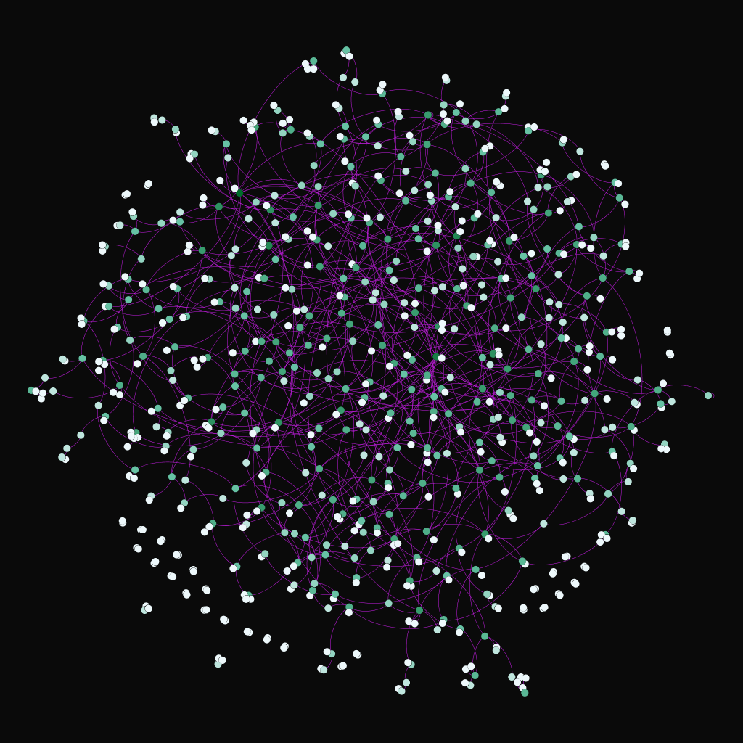
Generate Random Mesh Network Graph nodes locations
Wireless Mesh Network Nodes Position Matrix
Matrix dimension: 1000*3
First column is nodes id
Second column is nodes x position
Third column is nodes y position

Slide 19
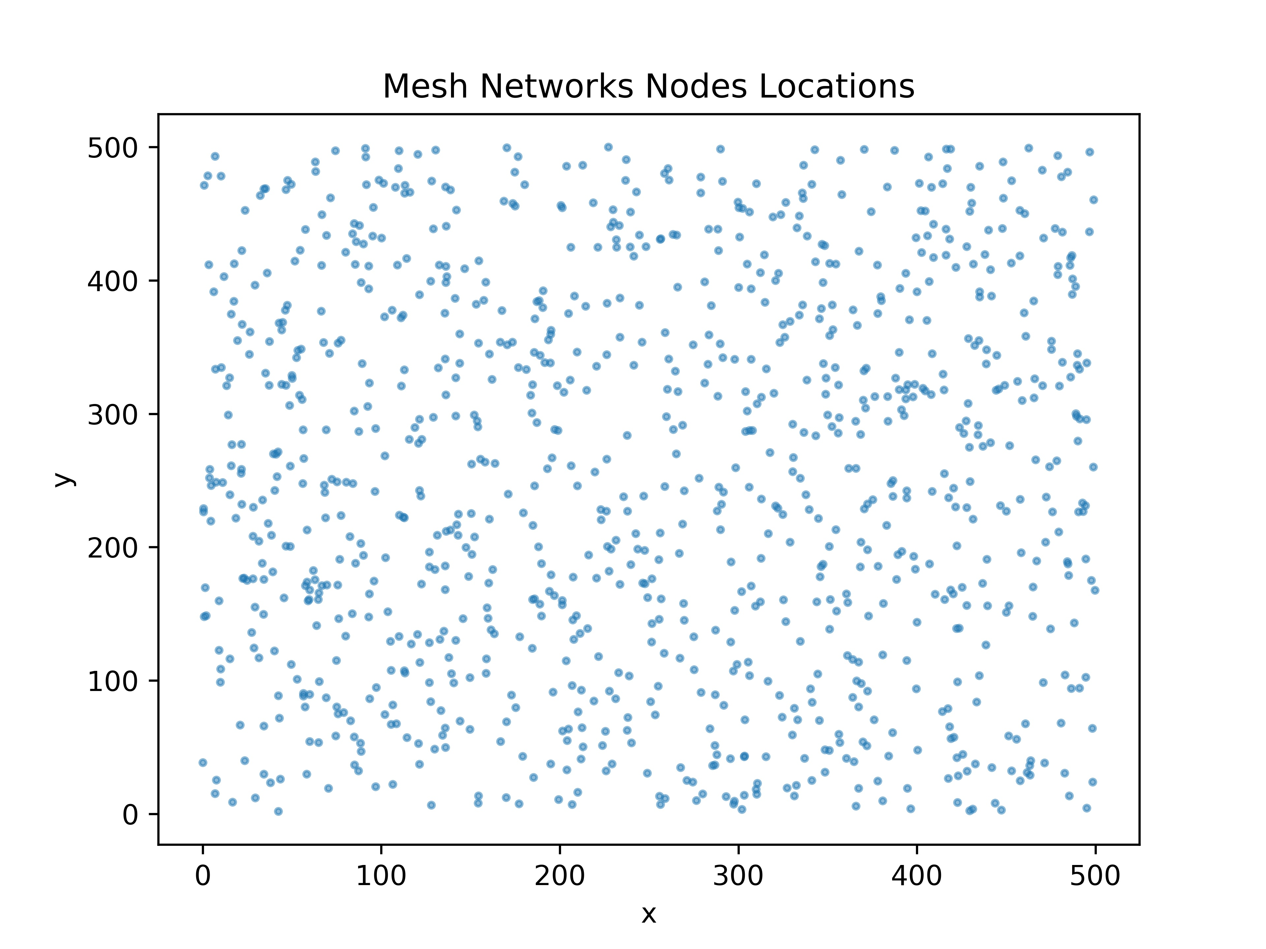
Generate Random Mesh Network Graph nodes locations
Nodes locations were generated by uniform distribution

Slide 20
Generate Random Mesh Network Graph link matrix
Pairwise distance between all nodes were calculated based on nodes locations
For simplicity, (1000*1000 pairs)
Nodes pairwise distance compared with communication range to determine whether it is possible to form a link or not
Link matrix dimension 1000000*5:
The first column is link index
The second column is first node index
The third column is second node index
The fourth column is pairwise distance
The fifth column is link indicator

Slide 21
Generate Random Mesh Network Graph link distance matrix
Distance between each pair of links were calculated
Link distance is calculated by the smallest distance
Four pairwise distance between each pair of nodes of two links
Link distance matrix dimension #(links*links)*5
The first column is first node id of first link
The second column is second node id of first link
The third column is first node id of second link
The fourth column is second node id of second link

Slide 22
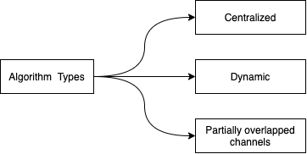
Channel Assignment Methods

Slide 23
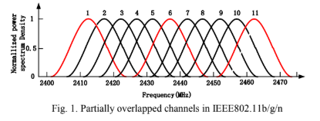
Channel Assignment Strategy
Partially Overlapped Assignment
Start
Min-interference and Connectivity-Oriented Partially Overlapped Channel Assignment (MC-POCA)
Calculate links assignment rank
Generate decreasing links queue
Utilize partially overlapped channels instead of 3 non-overlapped channels
Select channel by score function
Routing Selection
End
Partially Overlapped Channel Assignment
P. Kyasanur and N.H. Vaidya, Routing and Link-layer Protocols for Multi-Channel Multi-Interface Ad Hoc Wireless Networks, SIGMOBILE Mobile Computing and Communications Review, vol. 10, no. 1, pp.

Slide 24
Strategy Advantages
Low time complexity
Effectively utilized partially overlapped channels
Easy to assess the link interference

Slide 25
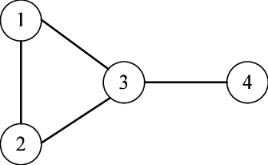
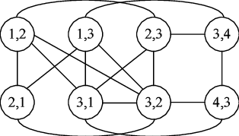
Strategy Drawbacks
Score function 1
Count how many the link pairs which have interference for each channel
Select the best channel with the minimum interference link pairs to assign
Example of a conflict graph
Figure Scource: https://www.researchgate.net/figure/The-conflict-graph-for-the-five-node-network_fig2_51915978

Slide 26
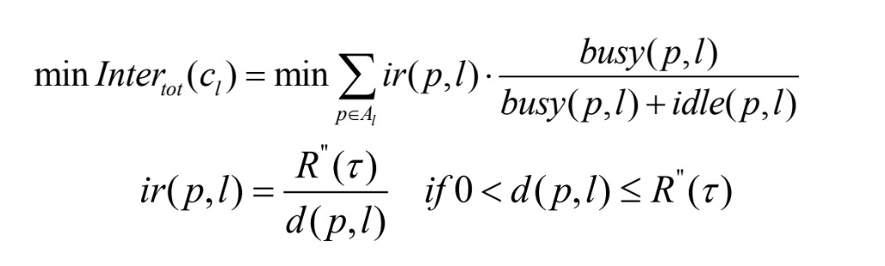
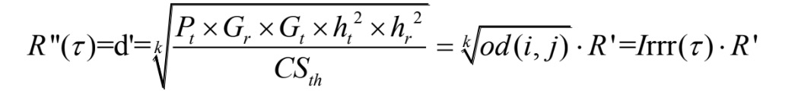
Strategy Drawbacks
Score function 2
Get the distance of closest nodes of 2 links
Get ir(p,l), the interference distance ratio
For any assigned links, sum interference up and then choose the best channel

Slide 27
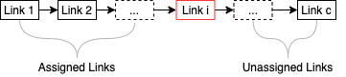
Strategy Drawbacks
Partially overlapped channel network may have much more interference link pairs
Node Interference range may not reasonable for calculating link interference range
Current assigned channel will interference unassigned empty links

Slide 28
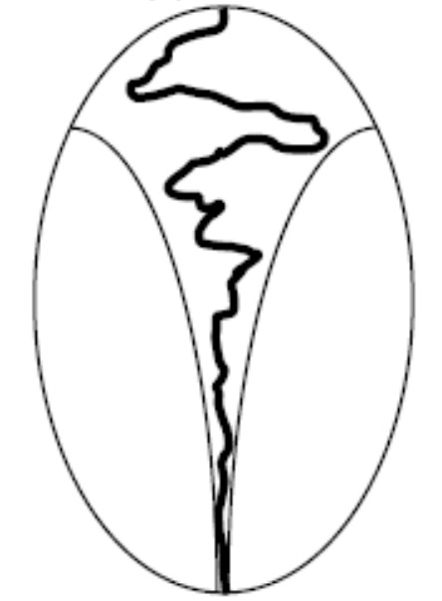
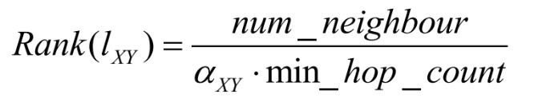
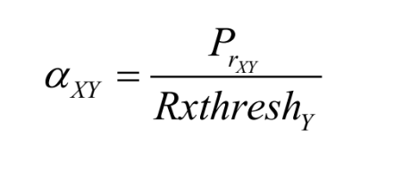
Strategy Drawbacks
Algorithm Structure
Once a link is assigned with certain channel, it’s impossible to modify or revise
The rank of links may change during the algorithm, but priority queue never update
Sequential Forward Channel Assignment
Figure Scource: https://www.cc.gatech.edu/~bboots3/CS4641-Fall2018/Lecture16/16_FeatureSelection.pdf

Slide 29
Score Function J(w) Design
Step 1. Measure $e_{0}(s,t)$ interferenced by other links
Step 2. Measure $e_{0}(s,t)$ interference assigned links
Step 3. Measure $e_{0}(s,t)$ interference unassigned empty links

Slide 30
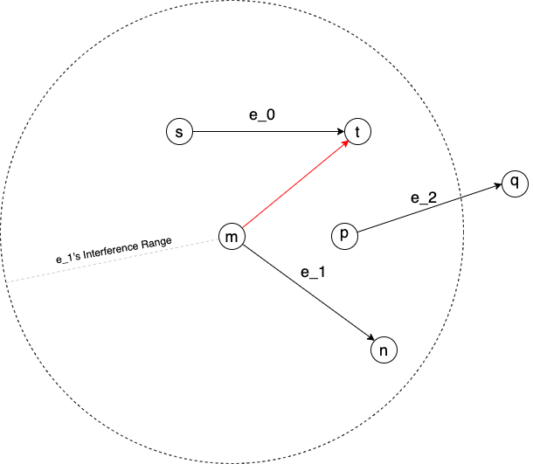
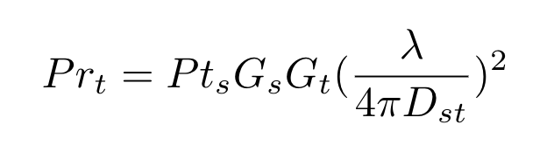
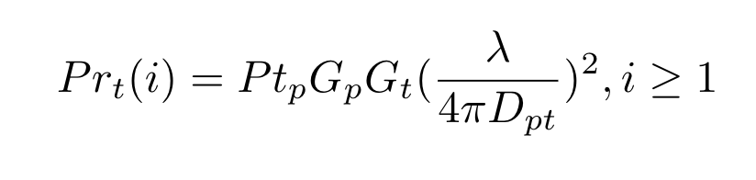
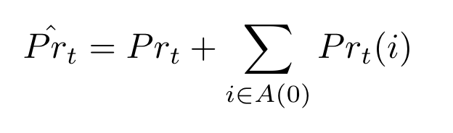
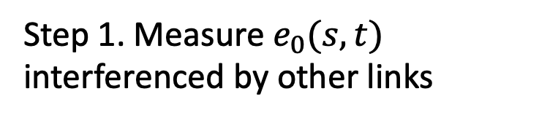
Score Function J(w) Design
Step 1. Measure $e_{0}(s,t)$ interferenced by other links

Slide 31
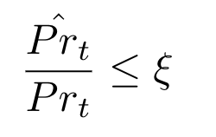
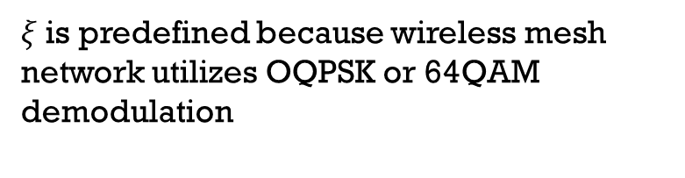
Score Function J(w) Design
Constraints
Define the receiver SNR as a threshold.
$ξ$ is predefined because wireless mesh network utilizes OQPSK or 64QAM demodulation

Slide 32
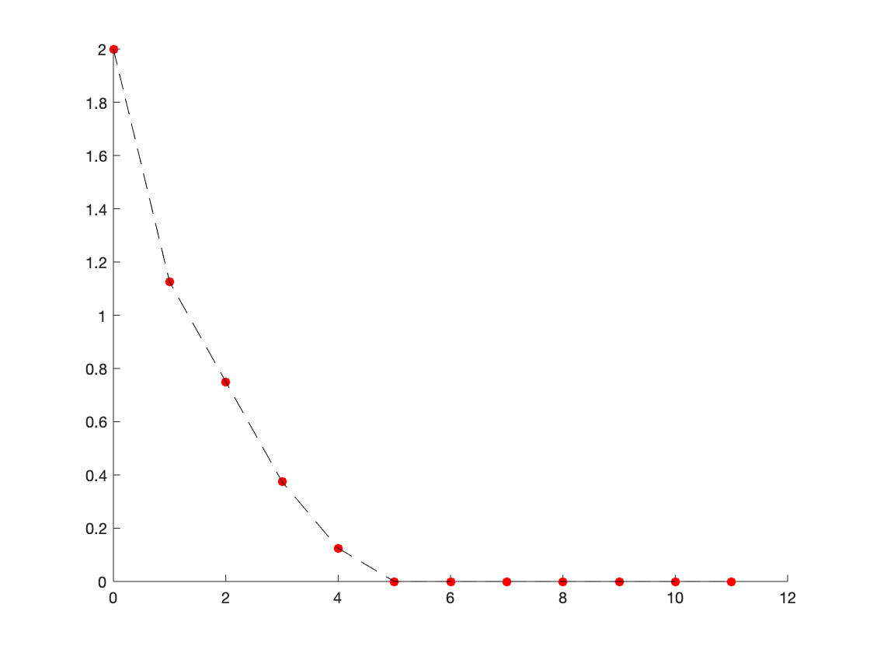
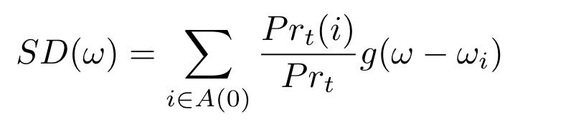
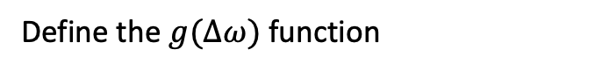
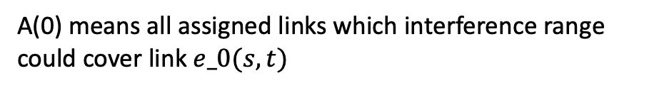

Score Function J(w) Design
Score for Step 1
Define the $g(Δω)$ function
A(0) means all assigned links which interference range could cover link $e_0(s,t)$
One example of$g(Δω)$ function

Slide 33
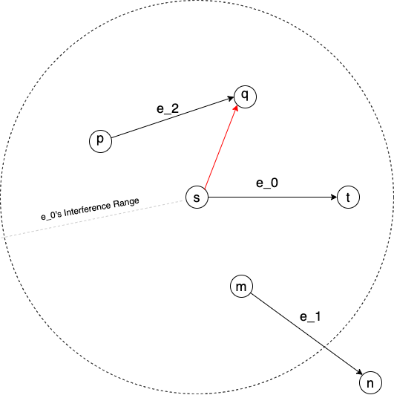
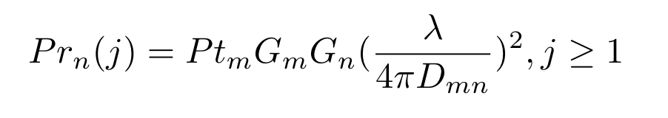
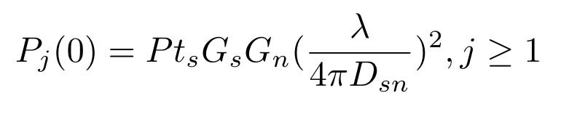
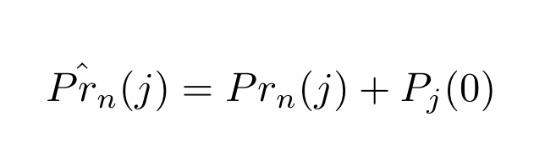
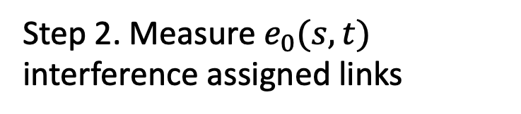
Score Function J(w) Design
Step 2. Measure $e_{0}(s,t)$ interference assigned links

Slide 34
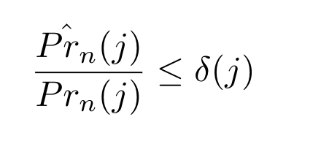
Score Function J(w) Design
Constraints 1
For each assigned link, we can define a SNR threshold.

Slide 35
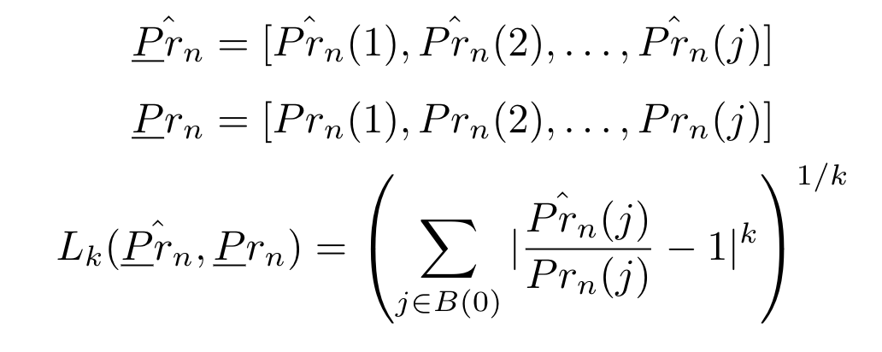
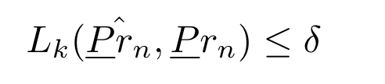
Score Function J(w) Design
Constraints 2
Calculate total variance of assigned links

Slide 36
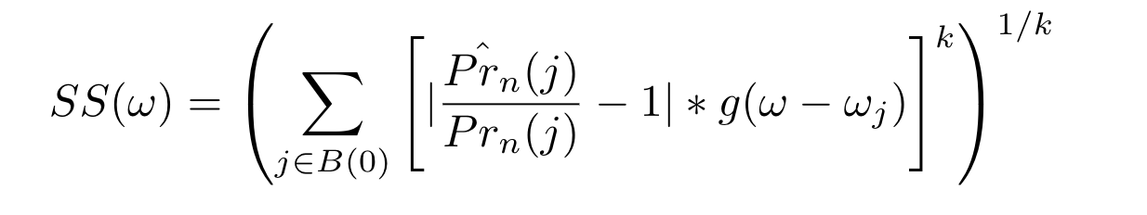
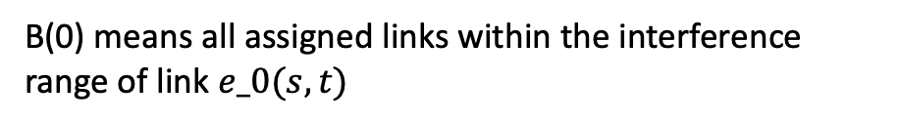

Score Function J(w) Design
Score for Step 2
B(0) means all assigned links within the interference range of link $e_0(s,t)$
One example of$g(Δω)$ function

Slide 37
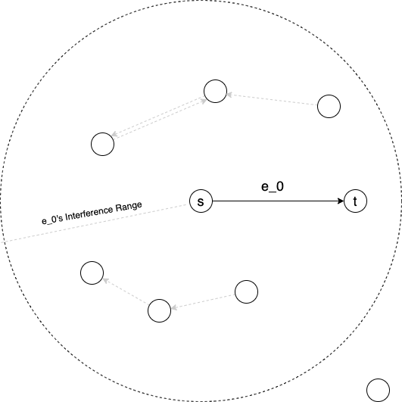
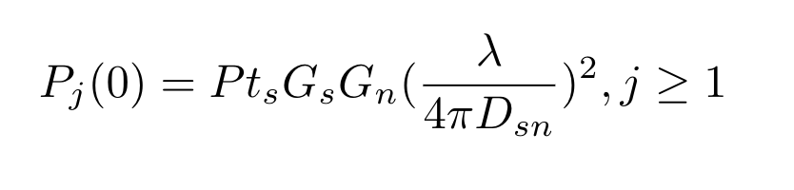
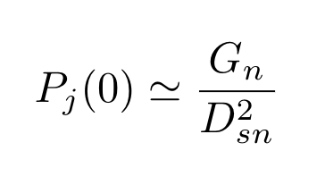
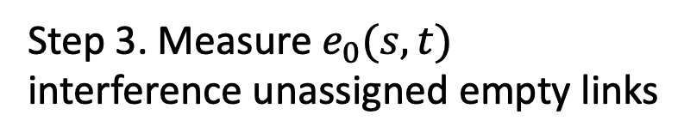
Score Function J(w) Design
Step 3. Measure $e_{0}(s,t)$ interference unassigned empty links

Slide 38
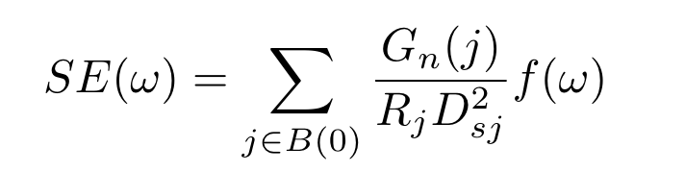
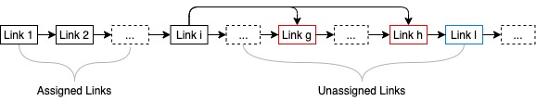
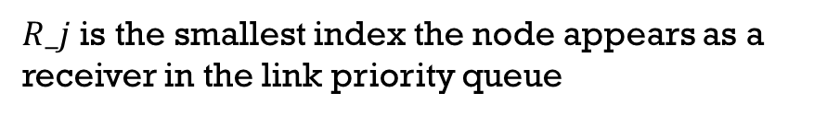
Score Function J(w) Design
Score for Step 3
$R_j$ is the smallest index the node appears as a receiver in the link priority queue

Slide 39
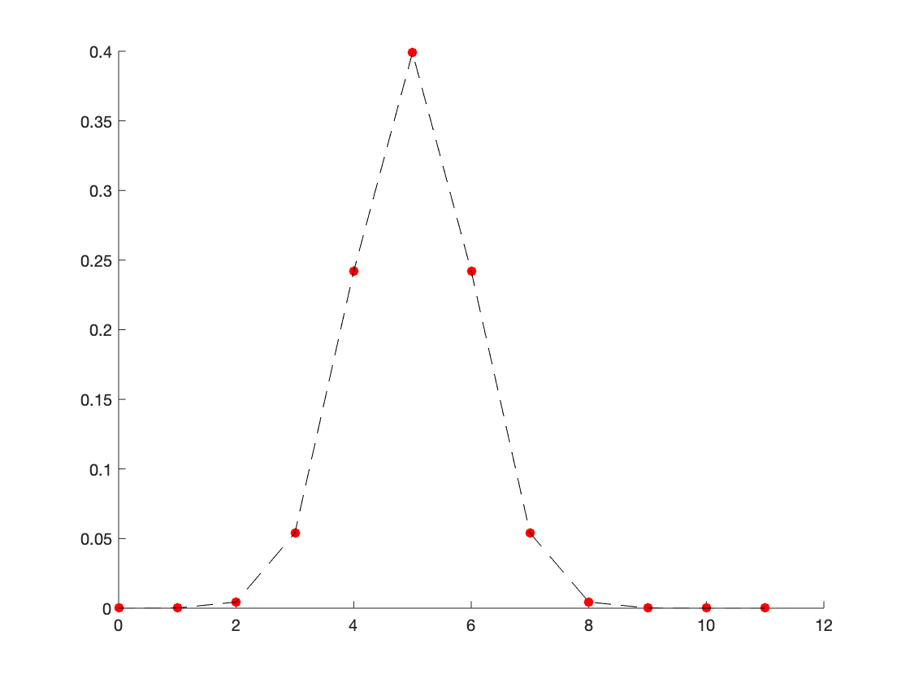

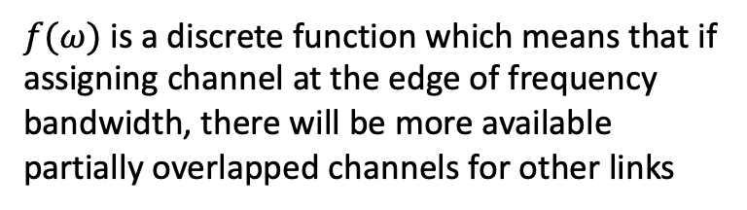
Score Function J(w) Design
Score for Step 3
$f(ω)$ is a discrete function which means that if assigning channel at the edge of frequency bandwidth, there will be more available partially overlapped channels for other links
One example of$f(ω)$ function

Slide 40
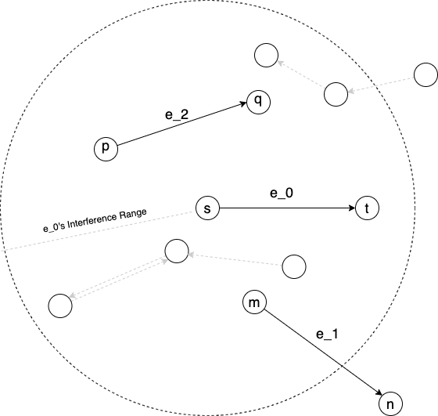
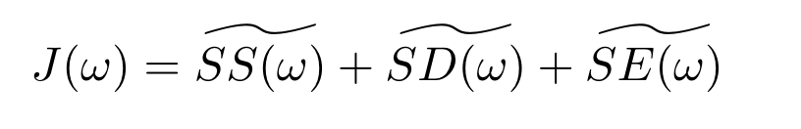
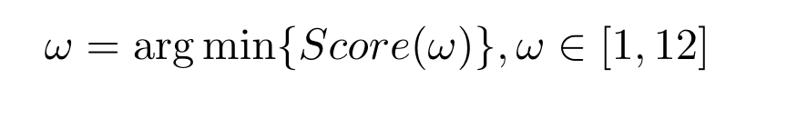
Score Function J(w) Design
One example of wireless mesh network

Slide 41
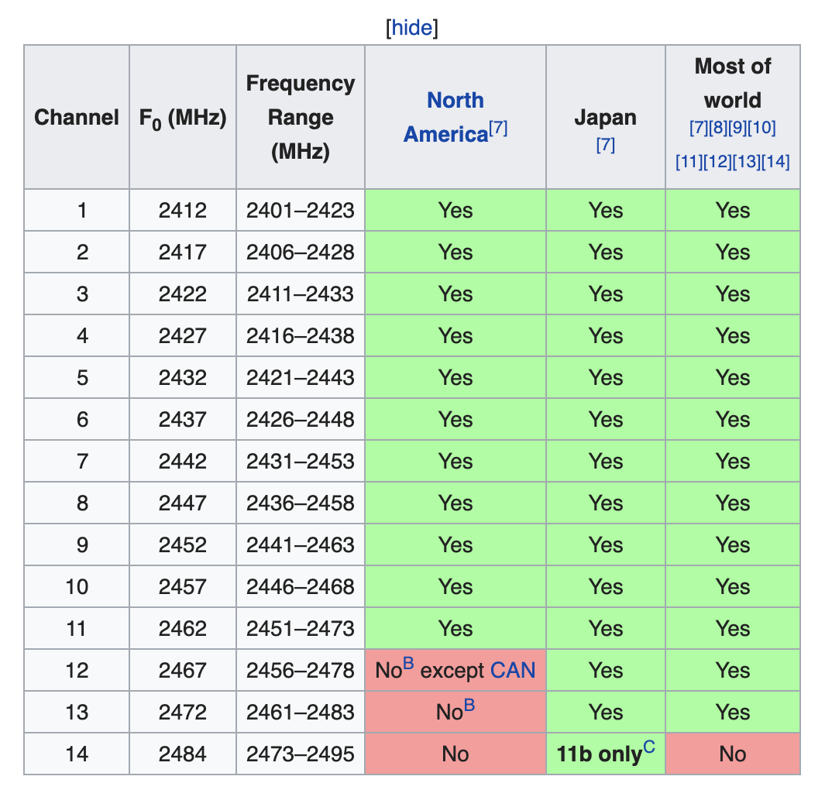
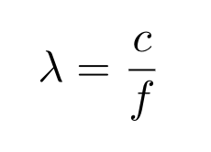
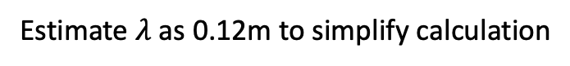

Score Function J(w) Design
Wavelength Estimation
$$0.1208m≤λ≤0.1244m$$
Estimate $λ$ as 0.12m to simplify calculation
Figure Scource: https://en.wikipedia.org/wiki/List_of_WLAN_channels

Slide 42

Algorithm Structure Design
Sequential Forward Channel Assignment (SFS)
Solution Space for SFS

Slide 43

Algorithm Structure Design

Slide 44
Algorithm Structure Design
Drawbacks
Once a link is assigned with certain channel, it’s impossible to modify or revise
The rank of links may change during the algorithm, but priority queue never update
One example of wireless mesh network

Slide 45


Algorithm Structure Design
Sequential Floating Forward Channel Assignment (SFFS)
Solution Space for SFFS
Future work

Slide 46
Analysis, Visualization, Evaluation
Graph based evaluation
Random Graph
Communication Graph
Density Analysis
1000 x 1000 area
Communication range 250
Conflict Graph
Interference range 250

Slide 47



Graph Analysis

Slide 48

Fractional Network Interference
$FNI=\frac{I\left(f\right)}{\left|E\left(G_{c}\right)\right|}$
Binary interference:
$I\left(f\right)=\sum_{\left(u,v\right)∈M}{t\left(u\right)t\left(v\right)r\left(u,v\right)}$
$t\left(u\right)$: traffic of link $u$
$r\left(u,v\right)$: whether interference exist or not
Non-binary interference:
$I\left(f\right)=\sum_{\left(u,v\right)∈M}{t\left(u\right)t\left(v\right)r\left(u,v\right)}c\left(f\left(u\right),f\left(v\right)\right)$
$c\left(f\left(u\right),f\left(v\right)\right)$: interference factor between two channels

Slide 49

Algorithm Step Visualization
Simple graph that has optimal solutions
FNI = 0.83
Rank = [100.0, 200.0, 300.0]

Slide 50

Algorithm Step Visualization
Simple graph that has optimal solutions
FNI = 0.24
Rank = [100.0, 200.0, 300.0]

Slide 51

Algorithm Step Visualization
Simple graph that has optimal solutions
FNI = 0.0
Rank = [100.0, 200.0, 300.0]

Slide 52

Algorithm Step Visualization
Another graph that has can’t remove all interference
FNI = 0.91
Rank = [100.0, 166.6, 200.0, 250.0, 266.6, 600.0]

Slide 53

Algorithm Step Visualization
Another graph that has can’t remove all interference
FNI = 0.59
Rank = [100.0, 166.6, 200.0, 250.0, 266.6, 600.0]

Slide 54

Algorithm Step Visualization
Another graph that has can’t remove all interference
FNI = 0.36
Rank = [100.0, 166.6, 200.0, 250.0, 266.6, 600.0]

Slide 55

Algorithm Step Visualization
Another graph that has can’t remove all interference
FNI = 0.33
Rank = [100.0, 166.6, 200.0, 250.0, 266.6, 600.0]

Slide 56

Algorithm Step Visualization
Another graph that has can’t remove all interference
FNI = 0.21
Rank = [100.0, 166.6, 200.0, 250.0, 266.6, 600.0]

Slide 57

Algorithm Step Visualization
Another graph that has can’t remove all interference
FNI = 0.18
Rank = [100.0, 166.6, 200.0, 250.0, 266.6, 600.0]

Slide 58

Evaluation
Number of Nodes vs. FNI

Slide 59
Evaluation
Number of Nodes vs. FNI

Slide 60

Evaluation
Assigned Links vs. FNI
100 Nodes

Slide 61
Work Distribution
Xiaoyan Li | Chang Liu | Zhongzheng Chen
Literature review Graph generation Generate link matrix Calculate link distance based on nodes locatioss | Algorithm structure design New scoring function SFS and SFFS Algorithm implementation | Graph analysis Algorithm steps visualization Performance metric implementation

Slide 62
Plans Next
Xiaoyan Li | Chang Liu | Zhongzheng Chen
Write abstract, introduction, related work of the report and generate graph | Write methodology, implementation details of the report | Write technical results and analysis of the report
Write future work, summary and lessons learned of the report

Slide 63
References
Bahl, Paramvir, Ranveer Chandra, and John Dunagan. 2004. “SSCH.” Proceedings of the 10th Annual International Conference on Mobile Computing and Networking - MobiCom ’04. https://doi.org/10.1145/1023720.1023742.
Beheshtifard, Ziaeddin, and Mohammad Reza Meybodi. 2018. “An Adaptive Channel Assignment in Wireless Mesh Network: The Learning Automata Approach.” Computers & Electrical Engineering 72 (November): 79–91.
Bongsu, Raja Hasyifah Raja, Abdullah Mohammed, and Mohamad Afendee Mohamed. n.d. “Recent Trends in Channel Assignment Algorithms for Multi-Radio Multi-Channel in Wireless Mesh Network.” https://pdfs.semanticscholar.org/b6a6/810ecda50bcdbb9386d1f7f9a64006da3090.pdf.
Cheng, Hongju, Naixue Xiong, Athanasios V. Vasilakos, Laurence Tianruo Yang, Guolong Chen, and Xiaofang Zhuang. 2012. “Nodes Organization for Channel Assignment with Topology Preservation in Multi-Radio Wireless Mesh Networks.” Ad Hoc Networks. https://doi.org/10.1016/j.adhoc.2011.02.004.
Ding, Yong, Yi Huang, Guokai Zeng, and Li Xiao. 2008. “Channel Assignment with Partially Overlapping Channels in Wireless Mesh Networks.” In Proceedings of the 4th Annual International Conference on Wireless Internet, 38. ICST (Institute for Computer Sciences, Social-Informatics and Telecommunications Engineering

Slide 64
References
Duarte, P. B. F., Z. M. Fadlullah, A. V. Vasilakos, and N. Kato. 2012. “On the Partially Overlapped Channel Assignment on Wireless Mesh Network Backbone: A Game Theoretic Approach.” IEEE Journal on Selected Areas in Communications 30 (1): 119–27.
Du, P., W. Jia, L. Huang, and W. Lu. 2007. “Centralized Scheduling and Channel Assignment in Multi-Channel Single-Transceiver WiMax Mesh Network.” In 2007 IEEE Wireless Communications and Networking Conference, 1734–39.
Ko, B., V. Misra, J. Padhye, and D. Rubenstein. 2007. “Distributed Channel Assignment in Multi-Radio 802.11 Mesh Networks.” In 2007 IEEE Wireless Communications and Networking Conference, 3978–83. Liu, Y., R. Venkatesan, and C. Li. 2009. “Channel Assignment Exploiting Partially Overlapping Channels for Wireless Mesh Networks.” In GLOBECOM 2009 - 2009 IEEE Global Telecommunications Conference, 1–5.
Meng, X., K. Tan, and Q. Zhang. 2006. “Joint Routing and Channel Assignment in Multi-Radio Wireless Mesh Networks.” In 2006 IEEE International Conference on Communications, 8:3596–3601.
Mogaibel, Hassen A., Mohamed Othman, Shamala Subramaniam, and Nor Asilah Wati Abdul Hamid. 2016. “Review of Channel Assignment Approaches in Multi-Radio Multi-Channel Wireless Mesh Network.” Journal of Network and Computer Applications 72 (September): 113–39.

Slide 65
References
Raniwala, Ashish, Kartik Gopalan, and Tzi-Cker Chiueh. 2004. “Centralized Channel Assignment and Routing Algorithms for Multi-Channel Wireless Mesh Networks.” ACM SIGMOBILE Mobile Computing and Communications Review. https://doi.org/10.1145/997122.997130.
Raniwala, A., and Tzi-cker Chiueh. 2005. “Architecture and Algorithms for an IEEE 802.11-Based Multi-Channel Wireless Mesh Network.” In Proceedings IEEE 24th Annual Joint Conference of the IEEE Computer and Communications Societies., 3:2223–34 vol. 3.
Skalli, H., S. K. Das, L. Lenzini, and M. Conti. 2006. “Traffic and Interference Aware Channel Assignment for Multi-Radio Wireless Mesh Networks.” In Proc. of ACM Int. Conf. on Mobile Comput. and Netw (MOBICOM) Pp, 15–26.
Skalli, H., S. Ghosh, S. K. Das, L. Lenzini, and M. Conti. 2007. “Channel Assignment Strategies for Multiradio Wireless Mesh Networks: Issues and Solutions.” IEEE Communications Magazine 45 (11): 86–95.
Subramanian, A. P., H. Gupta, S. R. Das, and J. Cao. 2008. “Minimum Interference Channel Assignment in Multiradio Wireless Mesh Networks.” IEEE Transactions on Mobile Computing 7 (12): 1459–73.
Wang, J., B. Xie, K. Cai, and D. P. Agrawal. 2007. “Efficient Mesh Router Placement in Wireless Mesh Networks.” In 2007 IEEE International Conference on Mobile Adhoc and Sensor Systems, 1–9.

Slide 66
References
Yin, Z., Z. Li, and M. Chen. 2007. “A Novel Channel Assignment Algorithm for Multicast in Multi-Radio Wireless Mesh Networks.” In 2007 12th IEEE Symposium on Computers and Communications, 283–88.
Zhao, Xiongwen, Siyuan Zhang, Liang Li, Zhaoyan Qu, Yu Zhang, Yi Ding, and Junyu Liu. 2018. “A Multi-Radio Multi-Channel Assignment Algorithm Based on Topology Control and Link Interference Weight for a Power Distribution Wireless Mesh Network.” Wireless Personal Communications 99 (1): 555–66.
Kim, S.-H., Kim, D.-W., Suh, Y.-J., 2011. A cooperative channel assignment protocol for multi-channel multi-rate wireless mesh networks. Ad Hoc Netw. 9, 893–910.
Chiu, H.S., Yeung, K., Lui, K.-S., 2009. J-car: an efficient joint channel assignment and routing protocol for IEEE 802.11-based multi-channel multi-interface mobile ad hoc networks. IEEE Trans. Wirel. Commun. 8, 1706–1715.
Mogaibel, H.A., Othman, M., Subramaniam, S., Hamid, N.A.W.A., 2012. On-demand channel reservation scheme for common traffic in wireless mesh networks. J. Netw. Comput. Appl. 35, 132–151.
Chaudhry, A., Ahmad, N., Hafez, R., 2012. Improving throughput and fairness by improved channel assignment using topology control based on power control for multi-radio multi-channel wireless mesh networks. EURASIP J. Wirel. Commun. Netw. 2012, 1–25.
Draves, R., Padhye, J., Zill, B., 2004. Routing in multi-radio, multi-hop wireless mesh networks. In: Proceedings of the 10th Annual International Conference on Mobile Computing and Networking (MobiCom 04), ACM, New York, NY, USA, pp. 114–128.

